Slide 1


HouseMate
Designed by Georgi Nikolov: 3774163 Daniel Vaswani: 3782689 Khoa Doan: 3603407

Slide 2

Front Page

Slide 3
Contents
Introduction
Project Description
Problems
Solutions
Employee UI
Student UI
Results
RefLECTION

Slide 4
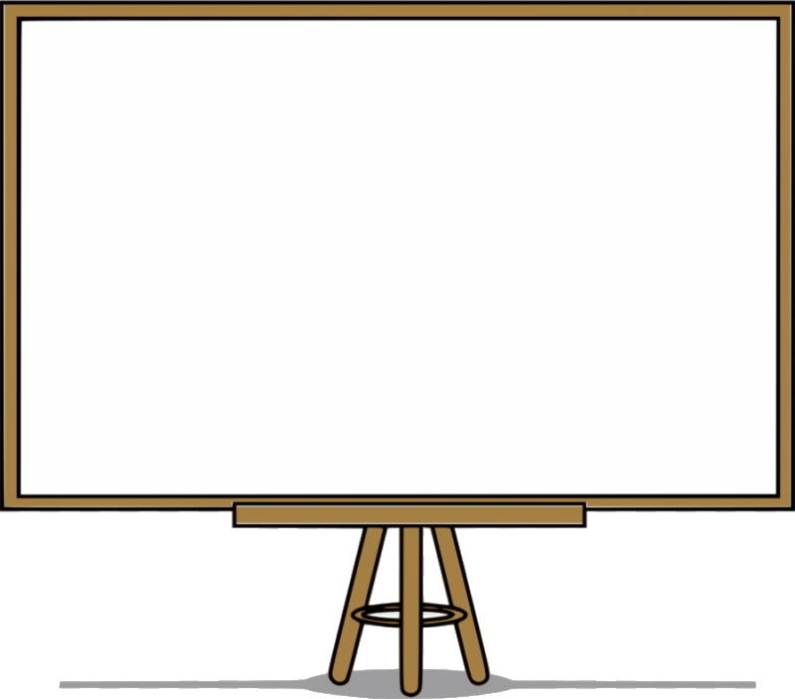
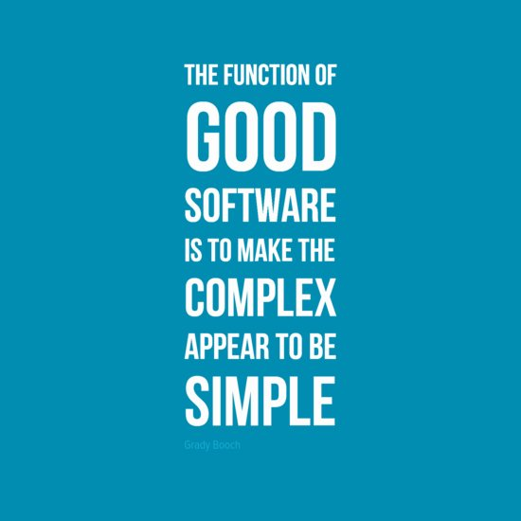
Introduction
Student Housing BV
Multiple buildings available for rent
Hard to coordinate tenants
Software solution
- Grady Booch

Slide 5
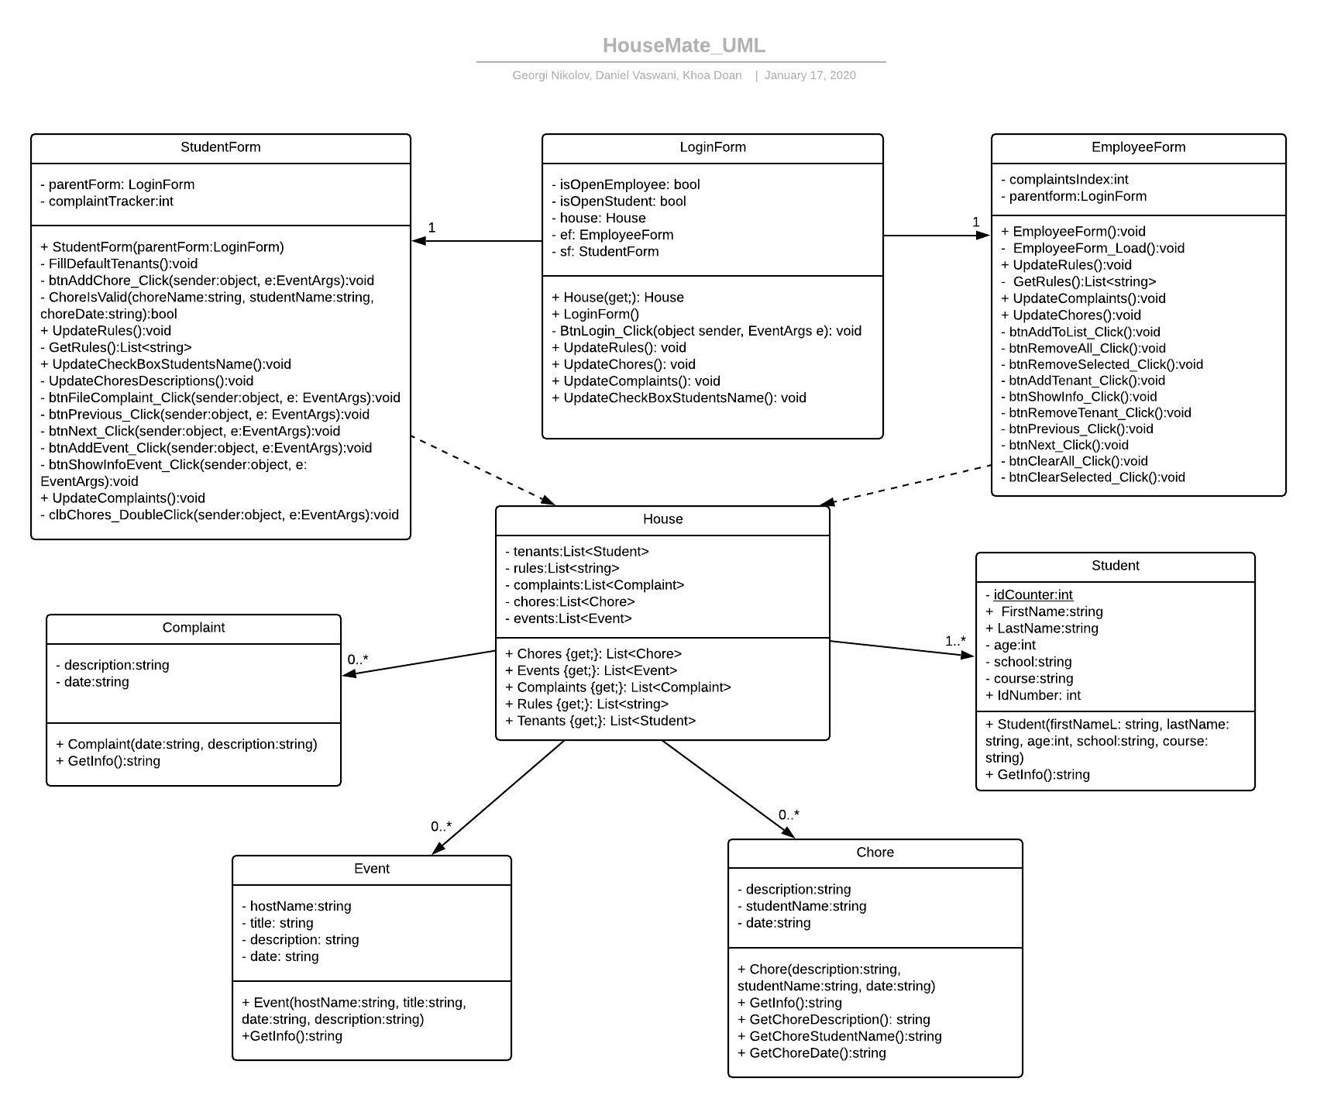
Project Description
Software application for easy:
Share of information
Management of tenants
Coordination

Slide 6

Problems
People don’t have an incentive to follow the rules

Slide 7

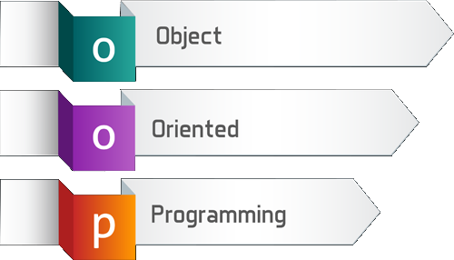

Solutions
C# Windows Form Application
Object-Oriented Programming (OOP)

Slide 8
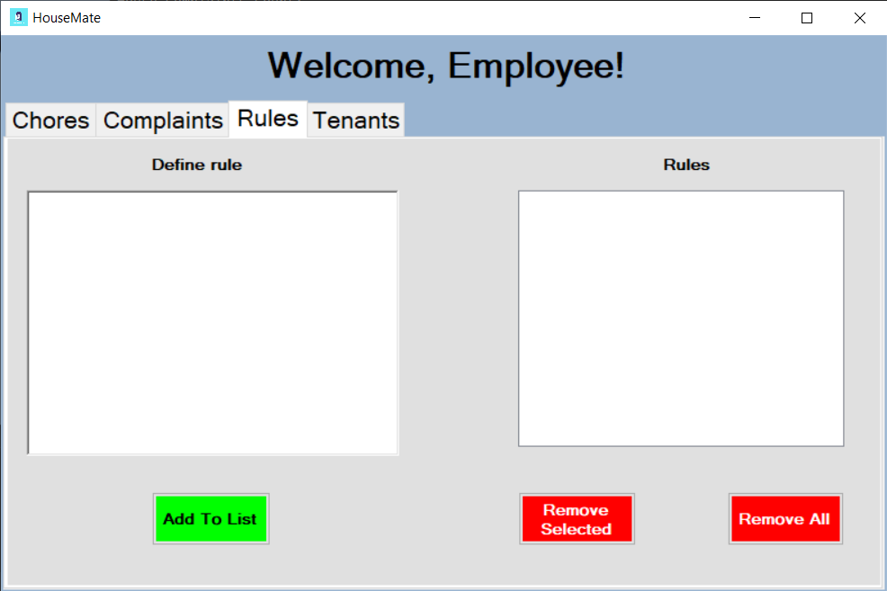

Employee UI

Slide 9
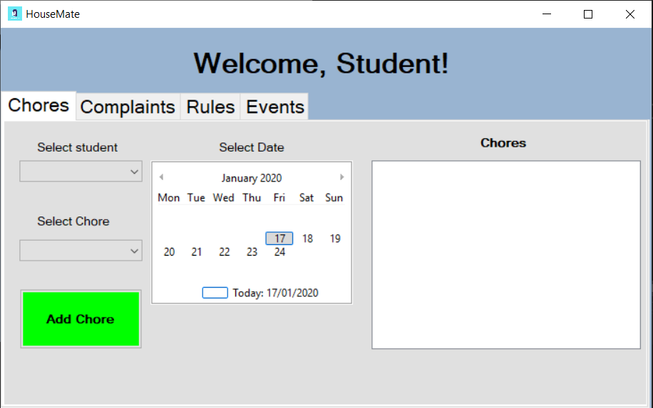

Student UI

Slide 10
Results
Improved our skills in:
Ideation
Development
Testing
Final Product
UML
Git
OOP concepts

Slide 11




Reflection
Working in a group
Learning new concepts (OOP)
Coding & Debugging
Deliver the final product

Slide 12
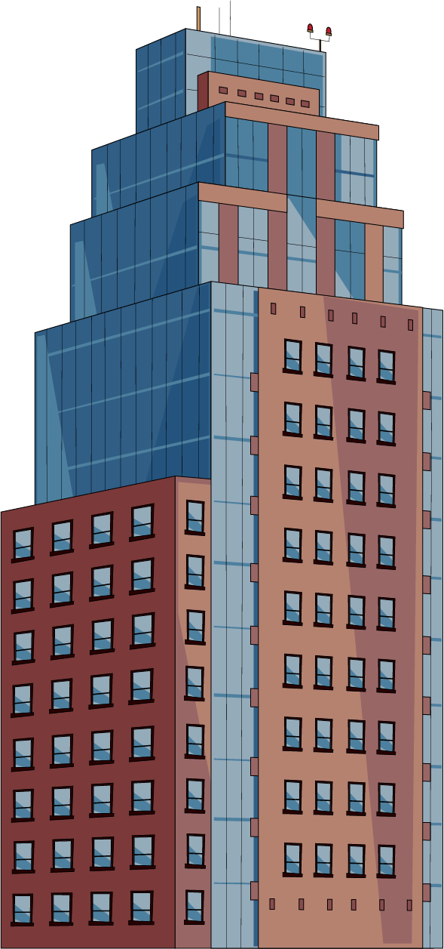

Thank you for your attention!

